Slide 1
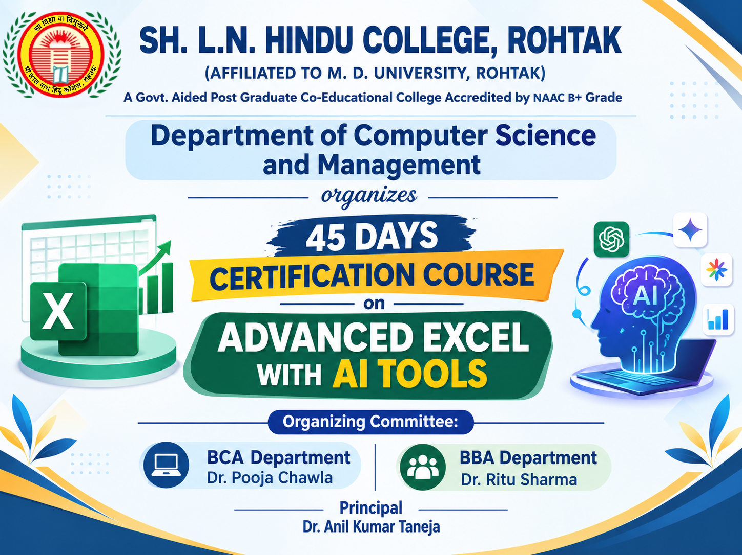
Starting from:- 14 September 2026
Resource Person- Mr. Mukesh Juneja

